Slide 1
Spring 2017 Deloitte Project – STEM Division
04/12/2017

Slide 2









SP17 SIBC Deloitte Project: Travel Team
Lan Zhou
Sophomore
ACMS, Financial Economics
Andrew Fuller
First Year of Studies
ACMS
Lucas Don
Sophomore
Business Analytics
Daniel Tawil
Junior
Chemical Engineering
Edward Yuan
First Year of Studies
Computer Science
Ryan McAndrews
First Year of Studies
Business and Economics
Patrick Stepien
Junior
Chemical Engineering
Wendi Gradoville
First Year of Studies
Economics and ACMS
Vince Sellner
Junior
Mechanical Engineering

Slide 3
Introduction
Executive Summary
Industry Overview
Winning Strategy
Team Composition
Team Management
Team Recruitment
Payroll
League and Location
Location
League
Risks
Conclusion

Slide 4
Executive Summary
Client
Situation:
Strategy Recommendation:
Client wants to start a new MLB Team that will make the playoffs by 2020
Choose a location between Charlotte, NC; Las Vegas, NV; and Memphis, TN
Choose a league to optimize winning
Focus on recruiting experienced pitchers from the US system to make the playoffs.
Join the National League
Start the team in Charlotte, NC

Slide 5
Introduction
Executive Summary
Industry Overview
Winning Strategy
Team Composition
Team Management
Team Recruitment
Payroll
League and Location
Location
League
Risks
Conclusion

Slide 6
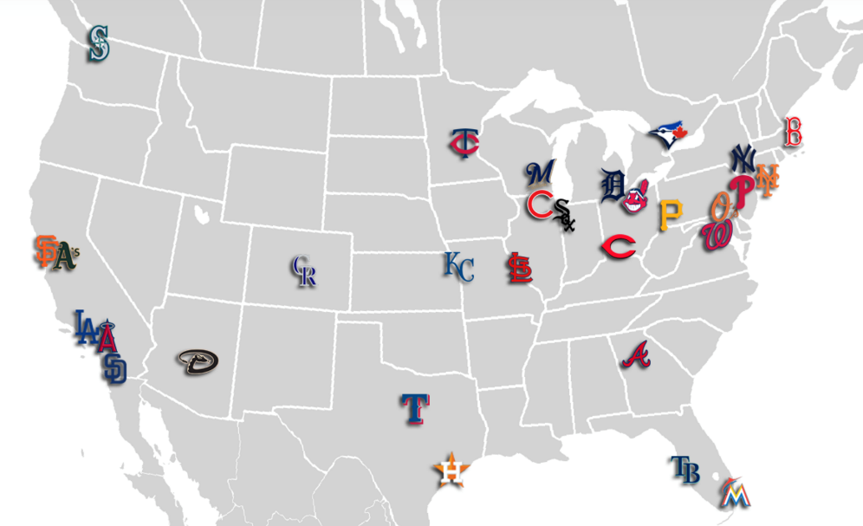
MLB Industry Overview
Industry Landscape
Map of Major League Baseball
Founded in 1903
Composed of the American and National Leagues, both made up of 15 teams
Expected to maintain recent growth
High competition and increasing barriers to entry
50% viewers are 55 or older, 70% are male, 83% are white
Las Vegas
Charlotte
Memphis
Revenue Growth
Key Successful Factors
Loyal Customer Base
Diversified Revenue Stream
Need to be able to generate profits from a variety of sources
Appeal to Younger Demographics
Must attract future fans for continued customer base
Dedicated fans will be continuous customers, regardless of team performance
Source: IBIS World (2016), Statista

Slide 7
Introduction
Executive Summary
Industry Overview
Winning Strategy
Team Composition
Team Management
Team Recruitment
Payroll
League and Location
Location
League
Risks
Conclusion

Slide 8
Focus on pitching, particularly pitchers with low walk and home run rates
Pitching vs. Hitting
Specific Stats to Look For in Pitchers
There are three main pitching statistics that are almost entirely independent of team fielding
Home run rate (HR/9)
Walk rate (BB/9), and
Strikeout rate (K/9)
OPS+: Standardized Hitting Statistic (OPS: On-base Plus Slugging)
ERA+: Standardized Pitching Statistic (ERA: Earned Run Average)
The new franchise should focus on acquiring strong pitching in its first couple of years, defined as pitchers with low home run and walk rates.
Source: Baseball Reference
Notes:
Focus the team on pitching

Slide 9
Introduction
Executive Summary
Industry Overview
Winning Strategy
Team Composition
Team Management
Team Recruitment
Payroll
League and Location
Location
League
Risks
Conclusion

Slide 10
Managers who bring their team to the playoffs are older and experienced
Quick Facts
Average Age of a playoff Manager
10/10 playoff managers played in minor leagues
The average playoff manager was a manager for 2 years prior to making the playoffs
The top 3 vote-getters in ESPN The Magazine poll all made the playoffs in 2016
Winner of the poll – Joe Maddon – led Cubs to World Series win
Experience as a Manager
Experience as a player
For a greater chance at making the playoffs, a manager with extensive experience as a manager and as a player should be acquired.
Source: MLB.com, Baseball-Reference
Notes:
Also acquire strong, experienced team leadership.

Slide 11
Introduction
Executive Summary
Industry Overview
Winning Strategy
Team Composition
Team Management
Team Recruitment
Payroll
League and Location
Location
League
Risks
Conclusion

Slide 12
Analysis of Top 35 High-Value Starting Pitchers
Location
Experience
Draft Round
The most-valuable pitchers are experienced players drafted in early rounds from the US system. The new franchise should recruit pitchers that fit these criteria.
Source: 6, Baseball-Reference, Spotrac, MLB-Reference
Notes:
The best pitchers come from the US, are experienced, and are prioritized in drafting round picks.

Slide 13
Playoff teams focus on traded and drafted players
Playoff Roster Breakdowns: 2014 – 2016 Playoff Teams
Free Agent
Trade
Draft
International
For the past three seasons, the rosters of playoff teams have followed a consistent trend: 1-2 international players, 4-5 free agents, 6-8 drafted players, and 10-11 traded players. The new team should follow this pattern.
Sources: MLB, ESPN
Notes:
Playoff teams have had a number of traded players on the team.

Slide 14
Introduction
Executive Summary
Industry Overview
Winning Strategy
Team Composition
Team Management
Team Recruitment
Payroll
League and Location
Location
League
Risks
Conclusion

Slide 15
High Payroll Leads to Making the Playoffs
Relationship Between Payroll and Wins
Period of time | Correlation (R^2)
1 year | .0289
2 years | .1225
3 years | .16
4 years | .1936
5 years | .2401
Effect of Payroll on making the Playoffs, 1995-2013
There is little correlation between a high payroll and wins over one year, but high payroll correlates with sustained success
It is evident that the correlation between payroll and sustained success is high and teams in the top half of payroll make the playoffs at a significantly higher rate.
Sources: Fangraphs, FiveThirtyEight, Beneath Data, NBC Sports, IBIS World, Baseball Reference
Notes:
There is strong evidence that teams with a sustained high payroll correlates with making the playoffs.
Frequency of the playoff → y

Slide 16
Pitching is biggest contributor to payroll
Top pitchers are generally experienced and expensive, but will be necessary for the team to succeed and make the playoffs.
Source: Spotrac
Notes:
Much of the high payroll comes from pitching costs. This is likely due to the fact that the top pitchers have a number of years of experience and are of high priority for draft picks.
Draft has more uncertainty than free agency, and it typically takes multiple years for pitching prospects to develop – therefore, go with an expensive and experienced pitcher in order to win/make the playoffs.

Slide 17
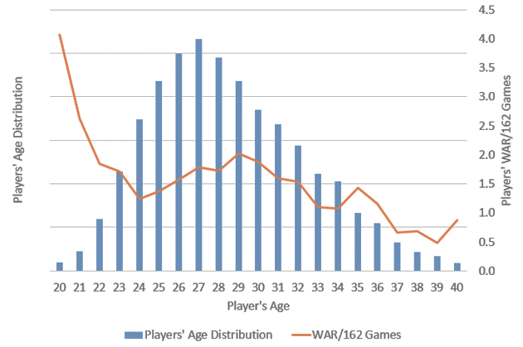
Young Hitters Provide Higher Return on Value
Rookie Contracts
Efficiency by Age
Player’s WAR/162 Games
Player’s Age Distribution
Some of the best hitters in the MLB are paid very little
WAR, or Wins Above Replacement, measure a player’s value to a team
WAR generally decreases over a career, especially past age 30
MLB teams have control over rookies for 6 years after being called up to major leagues
The team’s ideal payroll strategy is to maximize talent from cheap, young hitters and spend the rest of the money signing elite pitching.
Sources: Beneath Data, The Atlantic, Spotrac, Baseball Reference
Notes:
In order to offset these costs, focus on having most of the remaining players be young and on their rookie contracts. This leads to a payroll strategy of expensive (experienced) pitchers and young hitters.

Slide 18
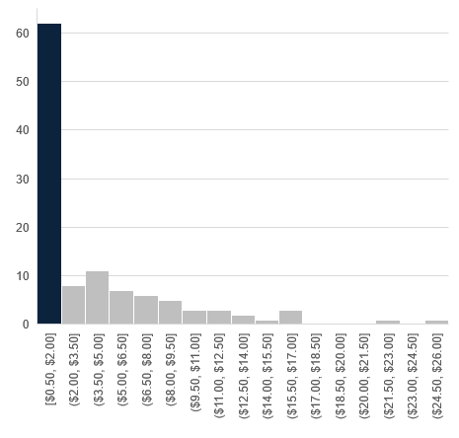
Proof of Concept: Case Study of 2014-2016 World Series Champs
Offset Veterans With Young Talent
High Returns Worth Pitching Costs
Frequency of Salaries ($millions)
Active Player Payroll by Position
Most players are in lowest payroll bracket
Recent World Series Champion spend the majority of active payroll on pitching. Veteran pitchers can be acquired due to low cost of the rest of the team.
Source: www.spotrac.com/mlb, www.baseball-reference.com
Notes:
This is a strong strategy, in fact, the last three winners of the world series have done something very similar. They spend most of their payroll on pitching talent, and then supplement that with a bunch of really cheap (i.e. young/rookie) players.
Pitching
Pitchers are 52% of active player payroll for these World Series teams
48% of active roster are pitchers
Young Players
Salary starts at $0.5mil and can remain so for about 4 years
49.5% of recent World Series active players had salaries at or below $1mil
New Team
A new team could spend more acquiring top pitching or hitting talents due to lower salary of young players

Slide 19
Introduction
Executive Summary
Industry Overview
Winning Strategy
Team Composition
Team Management
Team Recruitment
Payroll
League and Location
Location
League
Risks
Conclusion

Slide 20
Charlotte and Las Vegas match MLB viewer demographics
Demographics of Candidate Cities
Memphis
MLB Average Viewers
Charlotte
Las Vegas
The demographics of Charlotte and Las Vegas align well with the average MLB viewership while Memphis’s do not.
Sources: The Atlantic, U.S. Census Bureau, Infoplease, Forbes, statistica, hoovers
Notes:
Location in general should focus on maximizing team revenue. Team revenue is important because this money can go towards a good payroll, which is an important factor in making the playoffs.

Slide 21
Charlotte’s demographics are best suited for a successful team
Population
Normalized Income Trends
Minor League Attendance
Charlotte is the best location
Highest Population and Fastest Population Growth of the three locations
Greatest Current Interest in organized baseball
Consistently strong household Income level, compared to the national average
Source: www.deptofnumbers.com, www.bestplaces.net, carolinawandering2.files.wordpress.com, Forbes.com, www.baseball-reference.com
Notes:
Charlotte has highest population, highest income, and most interest. This will maximize the team revenue, and thus a sustained high payroll, which is important for team success. Note specifically that Las Vegas has a volatile income dependent on market trends, which is bad because you want to focus on sustained payroll/revenue, not just a couple good years followed by a couple bad years.

Slide 22











Charlotte provides the best market opportunities
Key Demographics
Cable TV Revenue ($M) and Market Size (M)
 | Charlotte | Las Vegas | Memphis
Media Market Size | #22 | #40 | #50
Metro Area Size | 2.4 million | 2.1 million | 1.3 million
Top 10 Major League Teams
Television Deals
MLB Sponsors
The new team must maximize its local cable TV deal in the 22nd largest market
Fox Sports Carolinas currently broadcasts Reds and Braves, but a team in Charlotte would easily replace them
MLB teams receive anywhere between $20-$200 million annually in TV deals, which has a huge impact on spending money on players
Charlotte has the largest Media Market Size of the three locations. There are also many company sponsorships for the MLB in Charlotte.
Sources: DataUSA, Wharton, Nielsen, espn.go.com, baseballpilgrimages.com
Notes:
Market opportunities can also contribute to a high payroll.

Slide 23
Introduction
Executive Summary
Industry Overview
Winning Strategy
Team Composition
Team Management
Team Recruitment
Payroll
League and Location
Location
League
Risks
Conclusion

Slide 24
National League provides higher chance of making the playoffs
Collective Division Win Percentage
(2012-2016)
Comparison
AL East
0.520
AL West
0.505
NL East
0.491
NL West
0.488
Payroll
9 of the top 15 payrolls in 2016 came from AL
Yankees and Red Sox (both AL) are consistent top spenders
Interleague Play
AL has won 54.7% of interleague games from 2004-2015
AL has winning interleague record over NL each year since 2003
Division Strength
Charlotte will likely be placed in the East or West, respectively
NL East and NL West have collective sub-0.500 records over the last five years
AL win% - NL win%
Increase in gap between AL and NL win% in the past decade. Better performance of the AL.
The team should enter into the National League because competitors have lower payroll as well as lower win percentages. This increases our teams winning potential.
Source: Lost in translation. Slide presenter going through to find the appropriate sources.
Notes:
National League offers the best chance of success.

Slide 25
Introduction
Executive Summary
Industry Overview
Winning Strategy
Team Composition
Team Management
Team Recruitment
Payroll
League and Location
Location
League
Risks
Conclusion

Slide 26
Major risks can be mitigated
Potential Risk
Mitigation Strategy
Injury
Ticket Sales
TV Deals
You invest heavily in a top pitching prospect who has season or career ending injury.
Coach proper throwing mechanics in young pitchers and create a data-developed rest schedule
Trends show the popularity of the MLB is declining while the average ticket price continues to rise
Focus on creating an engaging experience with specialty food, stadium technologies and events
The number of pay TV subscribers in rapidly decreasing making it harder to land a lucrative TV deal
Work with subscription streaming services like MLB.tv to create a more interactive viewing experience
Notes:
Thanks Wendi. We know with any big decision there are going to be risks involved and this decision is no different. However, we want to ensure you that not only have we considered the risks but have also thought through ways to mitigate them.
Injury Risk: - Half of all MLB pitchers placed on DL at some point during a season
- 25% of MLB pitchers have elbow ligament surgery some point which requires over a 12 months of recovery
Injury Mitigation: - Strong focus on coaching all players proper throwing mechanics (reduces stress on elbow+shoulders)
- Use a data-developed rest schedule by tracking how many pitches are thrown and rest recommendations
that have been developed by study data.
- On average 16.4 pitches/inning. 5.9 innings per game. = 97 pitches per game
- Based on data on average pitchers need 4 days of rest between games.
Ticket Sales Risk: - MLB total yearly ticket sales are down 8% from 2007 to 2016
- Trend will only increase:
- only 18% of children between 12-17 say would say baseball is favorite sport
- Little League Registration down 20% from 2007 to 2014
- Not only is interest decreasing but ticket prices have risen 39.6% from 2006 to 2016 (check these percent)
Ticket Sales mitigation: - Focus on creating engaging experience that goes past the game
TV Deals Risk: - # of Pay TV subscribers in US and Canada is declined by 2 million in each of the last 2 years
- 2015 and 2016. Also this is total of 4 million decrease since beginning of 2015
- Industry forecasts additional 5 million subscription drop by 2022
- Forecasr pay TV revenues to fall by 12.7% in next five years (by 2022)
TV Deals Mitigation: Already working on switching over to streaming services
- MLB.tv service which is not only better than watching it on TV but also less expensive
- Look into difference between out of and in market streaming

Slide 27
Introduction
Executive Summary
Industry Overview
Winning Strategy
Team Composition
Team Management
Team Recruitment
Payroll
League and Location
Location
League
Risks
Conclusion

Slide 28
Conclusion
Location
The team should be established in Charlotte, NC due to the good demographic fit and interest for traditional baseball, as well as a stable income above the national average.
League
The team should enter the National League in order to take advantage of the weaker performing opponents and avoid playing successful, dynastic teams in the American League.
Player Strategy
The team should focus the majority of it’s resources on acquiring experienced pitching talent. The rest of the team should be composed of young players who are still in their rookie contract.
Recommendation
Media + Management
Advertising and broadcasting media will be key revenue streams for supporting team operations. A respected and experienced manager should be hired to head the new team.

Slide 29
Any Questions?

Slide 30
Appendix

Slide 31
Case Study: 2016 World Series Champs CHI Cubs
Young Talent Offsets Veteran Salary
Invest in Pitchers, Specialty Players
Active Roster Salary vs Experience
Active Player Payroll by Position
Years
Young Players
Salary starts at about $0.5mil and can remain so for about 4 years
Even top draft picks are started on sub-million salaries
New Team
A new team could spend more acquiring a few top pitching or hitting talents due to lower salary of young players
Pitching and Specialty Positions
Pitchers are 56% of active player payroll; two-thirds of that are Starting Pitchers
One player rostered for first base but high salary makes the position 3% of total active player payroll
World Series Champion Cubs spent the most on pitching collectively and on specialty positions individually. Veteran players can be acquired due to low cost of rostering players with 4 or fewer seasons of experience.
Source: www.spotrac.com/mlb, www.baseball-reference.com
Notes:
LH: I would Spell out “Chicago” in title

Slide 32
Case Study: 2015 World Series Champs KC Royals
Reduce Costs with Young Talent
High Returns Worth Pitching Costs
Active Roster Salary vs Experience
Active Player Payroll by Position
Years
Salary Increase is Delayed
Almost one-third of active roster has 4 or fewer years of experience
Trend line points to increase by $0.5mil each season of play after first year, but jump occurs after year three
43% of players have salaries at or below $1mil
Pitching is Majority of Payroll
47% of active player payroll is pitchers
Relief Pitchers are as much of active payroll as all outfield combined
World Series Champion Royals spent half of total active payroll on pitching. Players with 4 or fewer years of experience make up almost one-third of the active roster. Salary increase is delayed for first 3 years.
Source: www.spotrac.com/mlb, www.baseball-reference.com
Notes:
LH: Fix source

Slide 33
Case Study: 2014 World Series Champs SF Giants
Reduce Costs with Young Talent
High Cost High Return Pitching
Active Roster Salary vs Experience
Active Player Payroll by Position
Years
Young Talent
58% of active roster at sub-$1mil salary
Salary above $1mil comes after 4+ years of experience
53% of Champion active roster has 4 or fewer years of experience
Pitching
Accounts for 52% of active player payroll
43% of active roster are pitchers
More than half of the Champion Giants team had 4 or fewer years of experience. Pitching accounts for majority of active payroll. Young players can be a solid foundation for a championship franchise.
Source: www.spotrac.com/mlb, www.baseball-reference.com

Slide 34
Other Managerial Factors
Notable Managerial Successes
Lack of Correlation Between Salary & Playoffs
Joe Maddon
World Series win, and back-to-back playoff appearances since taking over as Cubs manager in ’15
Jeff Banister
Back-to-back playoff appearances since becoming Rangers manager, 2015 Manager of the Year
Buck Showalter
Long-time manager prior to becoming Orioles’, 2014 Manager of the Year, made playoffs in third year at the helm
Manager’s salary is not a predictor of a team’s performance
It does not have an affect on winning percentage, attendance, or playoff appearance
The lack of a relation between manager’s salary and a team’s performance could be market inefficiency.
Recent Managerial Hires – 2016-17
Wins vs. Games Managed (Top 10 Managers)
Manager | Team | Notes
Torey Lovullo | ARI | 51 years old, no experience as permanent manager, long playing career in MLB
Brian Snitker | ATL | 60 years old, no playing or managing experience in MLB, long history in Braves organization
Rick Renteria | CWS | 54 years old, 1 year of managerial experience, played in MLB
Bud Black | COL | 59 years old, 9 years prior as manager, long playing career in MLB
Source: Baseball-Reference, ESPN The Magazine, MLB.com, Fox Sports, Value of MLB Managers (Journal Article)
Notes:
GRJ: consider putting this in appendix instead

Slide 35
Determining the Value of Managers
What Determines The Value of a Manager?
The Manager’s personal abilities
The fit between the team and the manager: experience, confidence
Onset of career, Managerial experience, confidence in him/herself
Different managers work well with different teams of players: the manager's personality and values matter for the team
Other factors that might affect the manager's productivity
Experience with minor league teams, age, manager's lifetime winning percentage/playoff record
Sources: Value of MLB Managers (Journal Article)
Notes:
TC: still don’t think three sides are needed for the manager topic. Slide 13 is strongest and could stand on its own without missing major points.
GRJ: could improve on slide visual appearance here

